Slide 1
we are the champions…

Slide 2
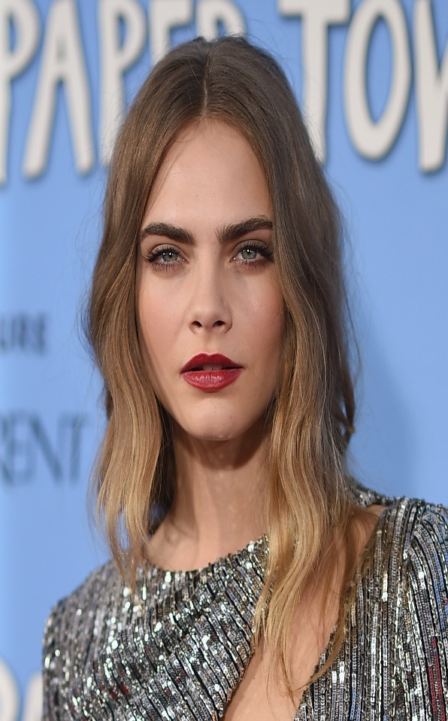
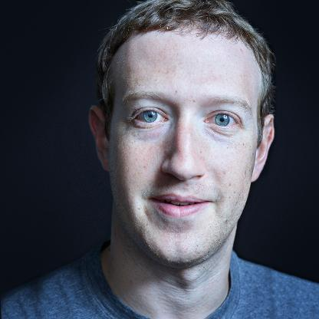
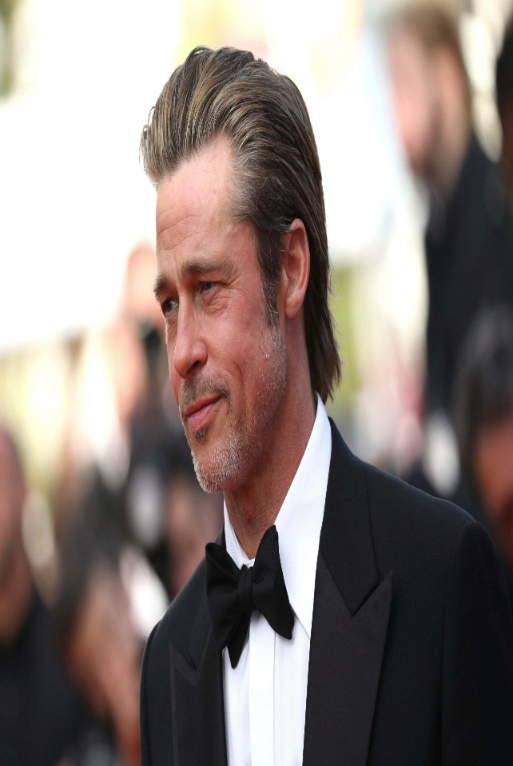
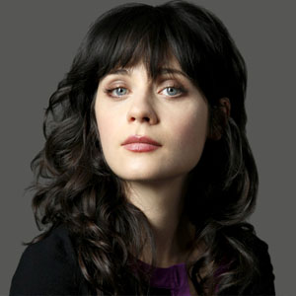
w

Slide 3
Who are they? What do they do? Are they regular people? Why? Who do you find more interesting to have a date with? Why?

Slide 4
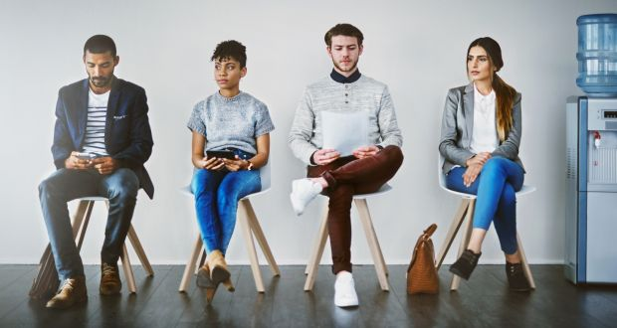
What do you think of these people? Have you met them before?

Slide 5
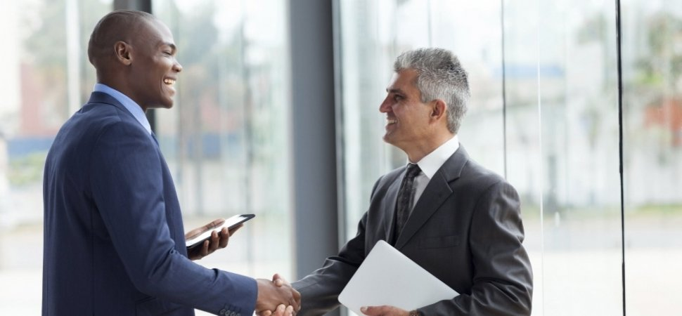
The first time we meet people we usually decide what they are like and if they are interesting.

Slide 6
First impression

Slide 7
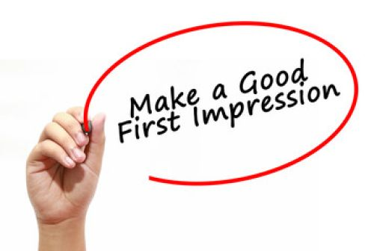
But how to make a good first impression? Do you have ant ideas?

Slide 8
Here are some awesome tips: To make a good impression, appearance doesn’t matter at all. Remember that names aren’t important. You don’t need to memorize other people’s names. Never break the silence let them feel comfortable. Try telling jokes over and over. Try to show your best don’t act like you always do. Try to say nice things about yourself you may even compliment yourself.

Slide 9
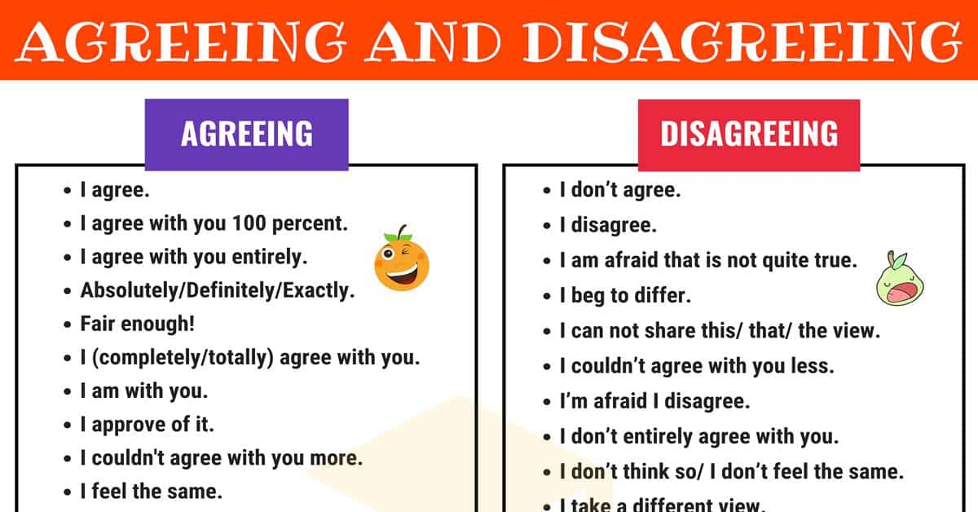
To what extent do you find the points sensible?

Slide 10
Here are some more points: Appearance matters. Dress a little nicer than you need to, When meeting new people. Use the names of the people you are talking to, for example: Amy, have you seen that movie yet? Break the silence with small talk about a topic that you think will interest others. When it’s in good taste, use humor. A joke can be a nice way to break the ice. Everyone likes compliments, so give plenty of them. Be yourself, and be sure to smile.

Slide 11
To what extent do you find the points sensible?

Slide 12
What’s “first impression”? Are you good at first impressions? What should we do to make a good first impression? What shouldn’t we do?

Slide 13
Should we dress up when we want to meet new people? Why? Should we tell a lot of jokes? Why? Should we memorize their names? Why?

