Slide 1
WE ARE IRAN-EUROPE
We are here to amaze...

Slide 2
a lesson to remember…

Slide 3
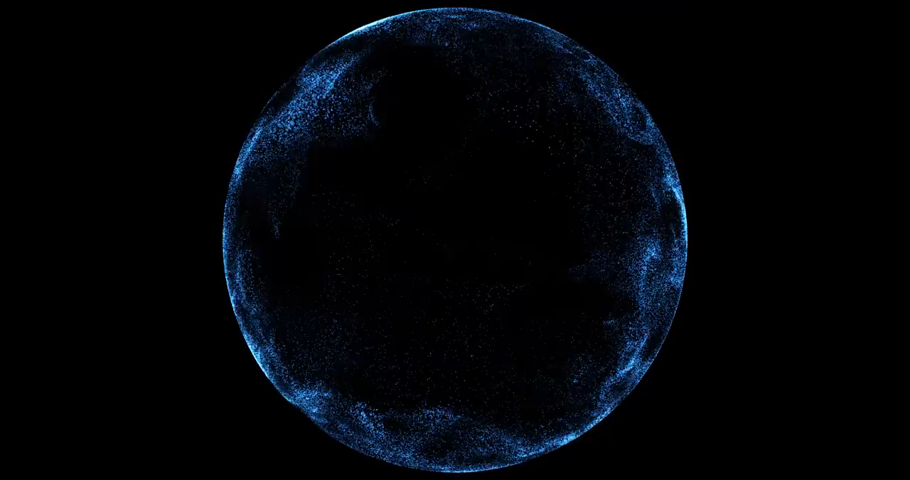
We are getting ready…

Slide 4
What do you think of Germany?

Slide 5
What do you think of the Middle East?

Slide 6
That’s a tough question,…
That’s a question with many possible answers…
I’m not quite sure but…

Slide 7
I believe …
In my opinion…
AS a matter of fact…
To be perfectly honest…

Slide 8
Eye-watering debts frankly approach

Slide 9
employment exporter world-beating industrial decline

Slide 10
Do Germans work more than others?
How was Germans’ progress after the second world war?

Slide 11
What do you think makes “made in Germany” a brand that everyone can trust?
What about made in Iran?

